Slide 1
NIC 3.0 Thermal Discussion - Updated Thermal Deck
11/14/2017
Yueming Li, Thermal Engineer, Facebook
John Fernandes, Thermal Engineer, Facebook
Joshua Held, Mechanical Engineer, Facebook
Jia Ning, Hardware Engineer, Facebook

Slide 2
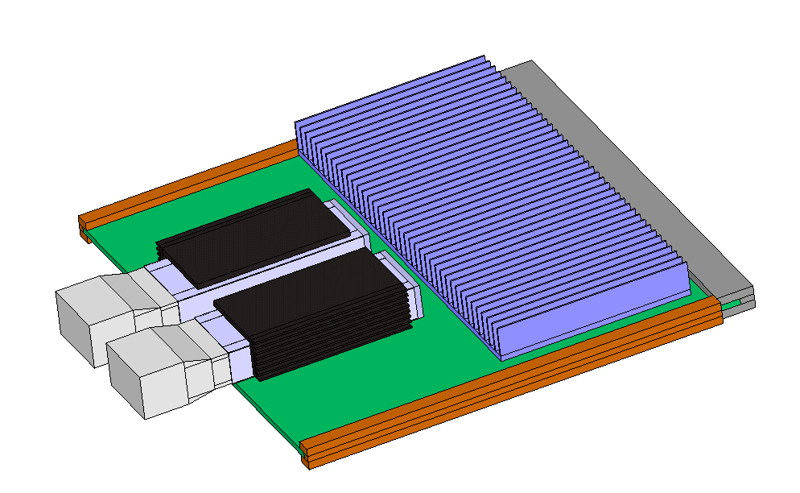
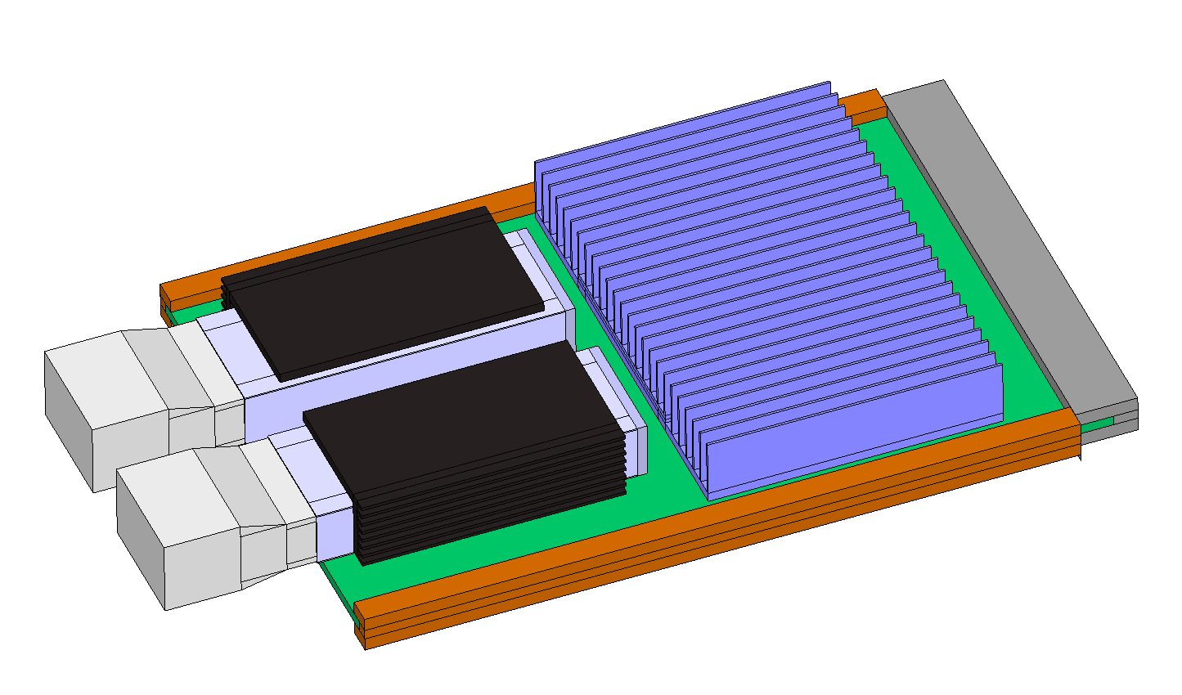
Thermal Boundary in Simulations
 | PCB Size
Small Size | 76x115
Large Size 1 | 120x115
Cold-aisle
Approach air temperature: 35°C
ASIC power: 15 ~ 40W
IO module: 2x QSFP (3.5W each)
Airflow: 150 ~ 500 LFM
Hot-aisle
Approach air temperature: 55°C
ASIC power: 15 ~ 40W
IO module: 2x QSFP (3.5W each)
Airflow: 150 ~ 750 LFM
Notes:
Initially, the models were built to make comparison between different options. The idea is to understand the trend and limitation for form factors, not the absolute value.
It would be great if NIC vendors can help provide calibrated models and feedbacks based on real data.
Small form factor
Large 1 form factor
Component model description:
ASIC (15-40W) – 2R model with (ΘJC - 0.4°C/W) (ΘJB - 10°C/W)
DRAM (0.4 W each) – 2R model with (ΘJC - 0.4°C/W) (ΘJB - 10°C/W) – large form factor only
IO module (QSFP, 3.5W each) – detailed model shared by Mellanox
No PCB power in this initial model

Slide 3
Thermal Model and Results
Latest models and simulation results are available on OCP Server/Mezz Subgroup Wiki
Model: http://files.opencompute.org/oc/public.php?service=files&t=260bfb5257a2466f6bd4490ff31f3358
Results: http://files.opencompute.org/oc/public.php?service=files&t=6e30e729b094d6c5f3a2eb49c7611901
Scan through 15W – 35W (ASIC) for small form factor under 150-500 LFM
Scan through 20W – 40W (ASIC) for large 1 form factor under 150-750 LFM
Use cases include both hot-aisle and cold-aisle
Provide a relative comparison for NIC 3.0 thermal performance as references
Further action - calibration needed from NIC vendors based on real test data

Slide 4
General Considerations
Temperature reporting interface - Required
Support digital temperature sensor for ASIC package
Ability to monitor optical module temperature
Temperature sensor accuracy – Required/Highly Recommended (TBD)
Further engagement required from NIC vendors
Desired range from system vendors
Power reporting interface (TBD)
Small form factor (low-power NIC): Optional
Large form factor (smart NIC): Highly Recommended
Please reach out to FB core group if you have any feedback on the three topics above
Propose to close out in two weeks (by end of November)

Slide 5
OCP NIC 3.0 Test Fixture
Purpose
Provide standardized test data across different NIC and system vendors
Requirements
Simple and easy adoption by both NIC and system vendors
Representative impedance and thermal data across different use cases
Need to consider both small and large form factor
Current status (On-going efforts and separate workshop session is arranged)
Dell (proposed test fixture - two options)
Intel (proposed test fixture)
HPE (consolidating evaluations for bypass and front plate perforations)
Spec options and timeline
Option 1: Define a separate spec “thermal reporting” – long-term efforts
Option 2: Incorporate into NIC 3.0 spec thermal section – align with mechanical timeline
Option 3: Define general concept in NIC 3.0 spec; Drawings and detailed level definitions fall into separate spec

