Slide 1
How SPIRAL Boosts Crypto of Authentication and Attestation by Over 20,000 Times
Xiaoyu Ruan and Will Stevens
{xiaoyu.ruan; william.a.stevens}@intel.com
For OCP security forum
March 5, 2019

Slide 2
Problem Statement
Problem
The authentication and attestation protocol (designed based on USB Type-C protocol) is not optimized for performance.
On constrained devices, running the protocol takes a long time during boot.
For many environments, boot performance is critical.
Solutions
Pre-shared key: Platform and Attestor Device both save pre-shared key.
SPIRAL
 | Legacy | Pre-Shared-Key | SPIRAL
Boot speed | Slow | Fast | Fast
Secure non-volatile storage required on attestor device | Not Required | Required | Not Required

Slide 3
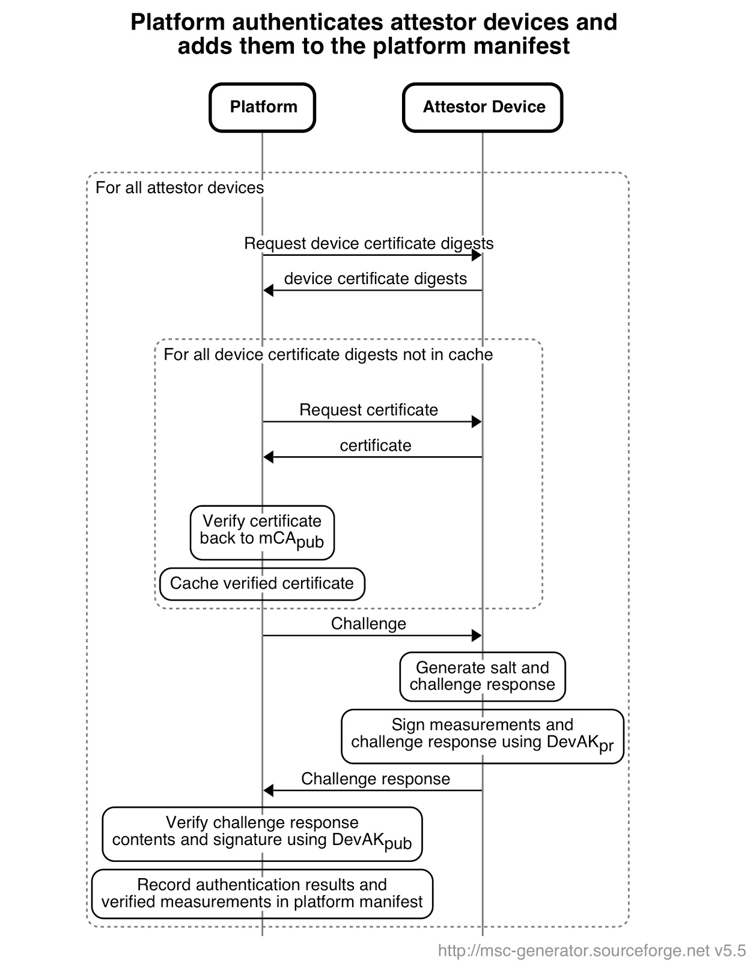
Legacy Protocol: Heavy Crypto (Asymmetric-Key) Every Boot
Requires asymmetric-key operations. Authentication of all attestor devices could take a long time.
Asymmetric-key operation is slow on constrained attestor devices.
Amount of data transmitted in “challenge Response” is big and slow on slow buses (e.g., I2C).
Attestation of Systems and System Components *DRAFT*
11.6. Authentication, Attestation, and Enrollment protocol

Slide 4
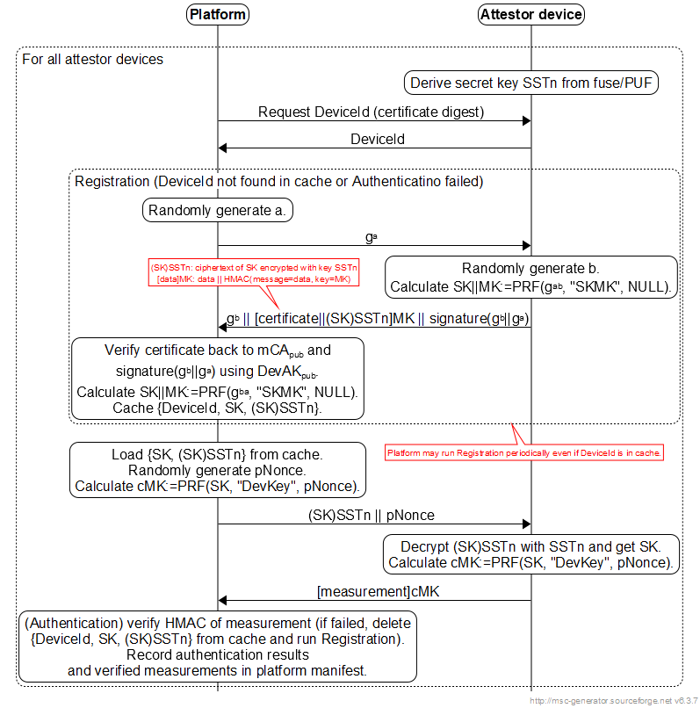
SPIRAL: Light Crypto (Symmetric-Key Only) Every Boot

Slide 5
Performance Comparison: Speeding up Crypto Operations by over 20,000x
SPEED
Algorithm | Performance
ECDSA P256 sign | 9.3 ms
ECDSA P256 verify | 8.0 ms
RSA 2048-bit sign | 16 ms
RSA 2048-bit verify | 2.0 ms
HMAC-SHA256 | 186 Mbytes/s
AES-128 | 267 Mbytes/s
Legacy protocol | ~17.3 ms (ECDSA) / 18 ms (RSA)
SPIRAL | ~0.8 μs (>20,000 times faster)
On Intel CSME (converged security and management engine), 200MHz
Data Transmission
32 bytes smaller than ECDSA/ECDH
224 bytes smaller than RSA

Slide 6
What’s Next?
Include in next revision of Cerberus as an option for authentication and attestation?
Intel is in the process of implementing Cerberus AC-RoT in several devices.
Incorporate in spec of Attestation of Systems and System Components?

Slide 7
Backup

Slide 8
SPIRAL-OneWay : Initiator Authenticates Responder
See Backup for flow when responder does not have DRNG

Slide 9
SPIRAL-TwoWay: Mutual Authentication
Responder is required to have DRNG in order to authenticate initiator.

Slide 10
SPIRAL-OneWay : When Responder Doesn’t Have DRNG

