Slide 2
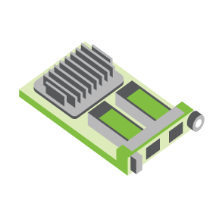
SERVER
OCP NIC Community Update October 2021 for Server Workgroup
Sub-group Project wiki: https://www.opencompute.org/wiki/Server/Mezz
Mailing List: https://ocp-all.groups.io/g/OCP-NIC
NIC3.0

Slide 3
Agenda
OCP Global Summit
TSFF thermal test fixture update
PCIe Gen5 SI test fixture

Slide 4
OCP Experience Lab Demo

Slide 5
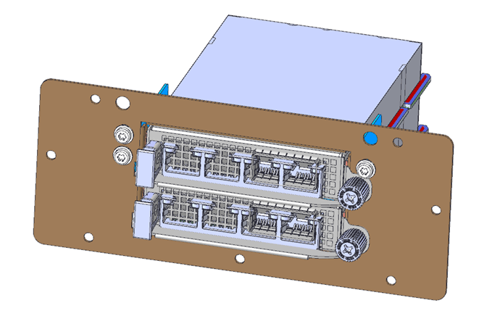
TSFF thermal test fixture
Mechanical files completed. It is under-review.
Uses existing TTF with 3 different components to convert to TSFF.

Slide 6
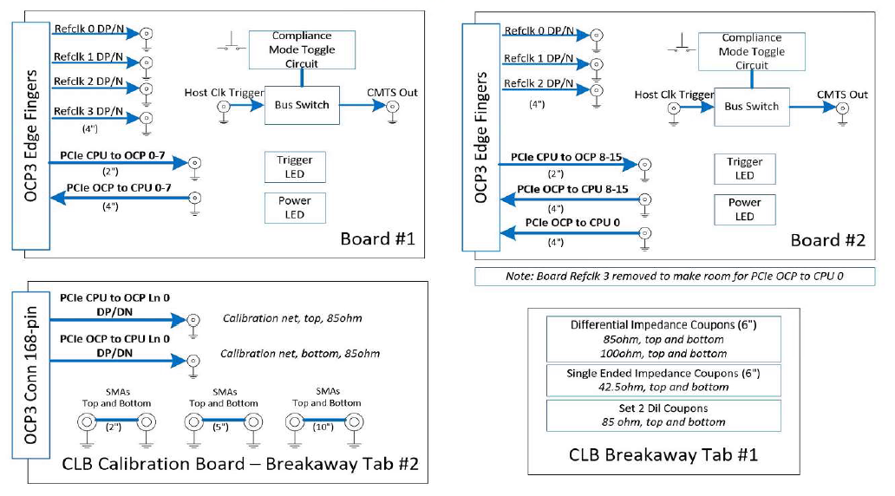
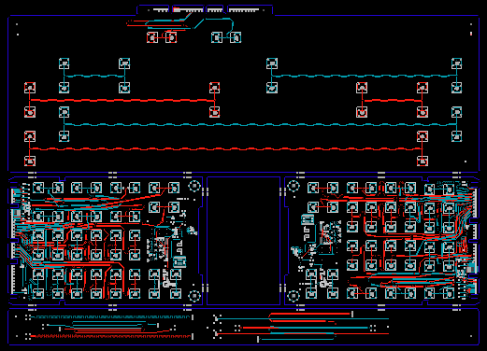
SI PCIe Gen5 test fixture update
Netlist block diagram
Current Gen5 status:
Schematic netlist is done
ECAD complete
Under-going community review
In lab by EOY (pending supply)
OCP3 SFF CLB Gen5 ECAD
Calibration
CLB board 1
CLB board 2
Impedance Coupon

Slide 7
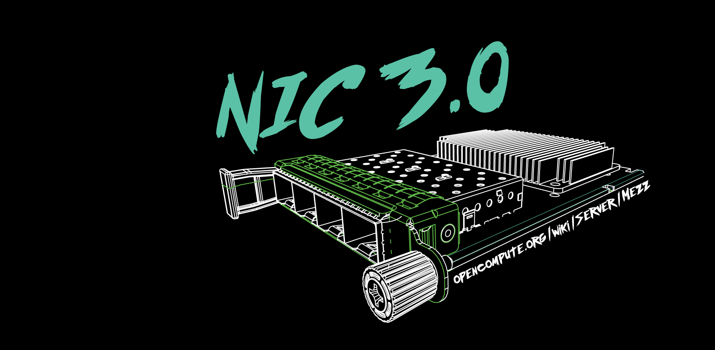

Slide 8
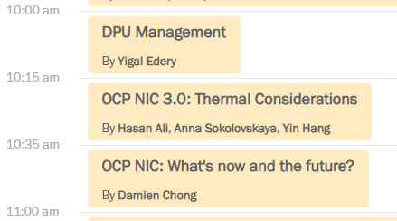
OCP Global Summit workshop

Slide 9
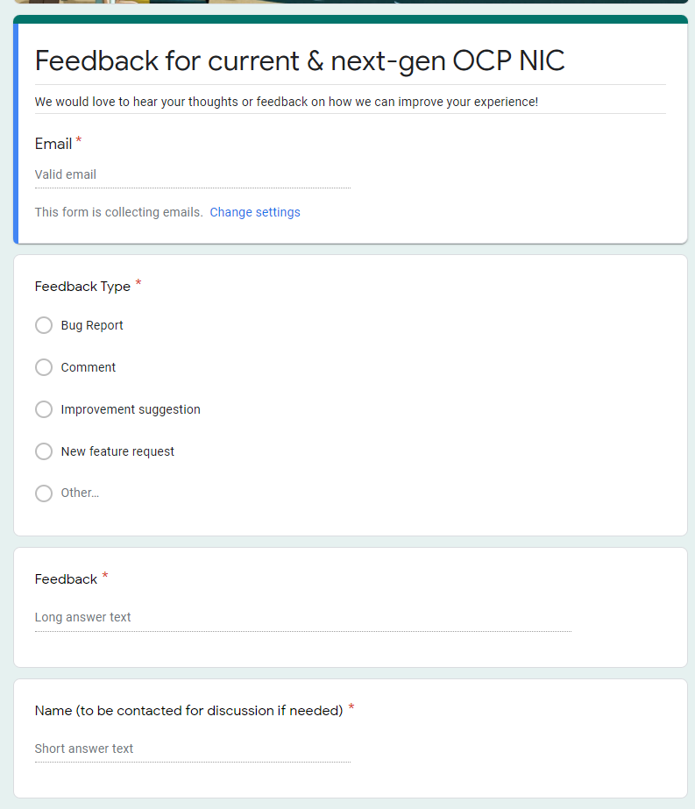
Gather feedback throughout the year
Provide your feedback at: https://tinyurl.com/feedback2ocpnic

