Slide 2
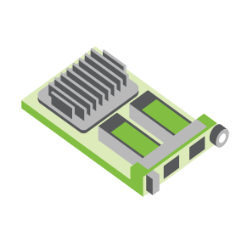
SERVER
OCP NIC Community Update December 2021 Sub-group Project wiki: https://www.opencompute.org/wiki/Server/Mezz
Mailing List: https://ocp-all.groups.io/g/OCP-NIC
NIC3.0

Slide 3
Agenda
PCIe Gen5 SI test fixture update
OCP Global Summit
Discussion bin list

Slide 4
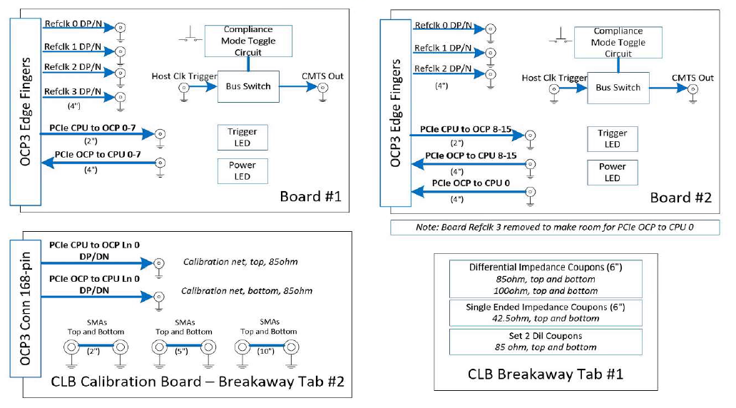
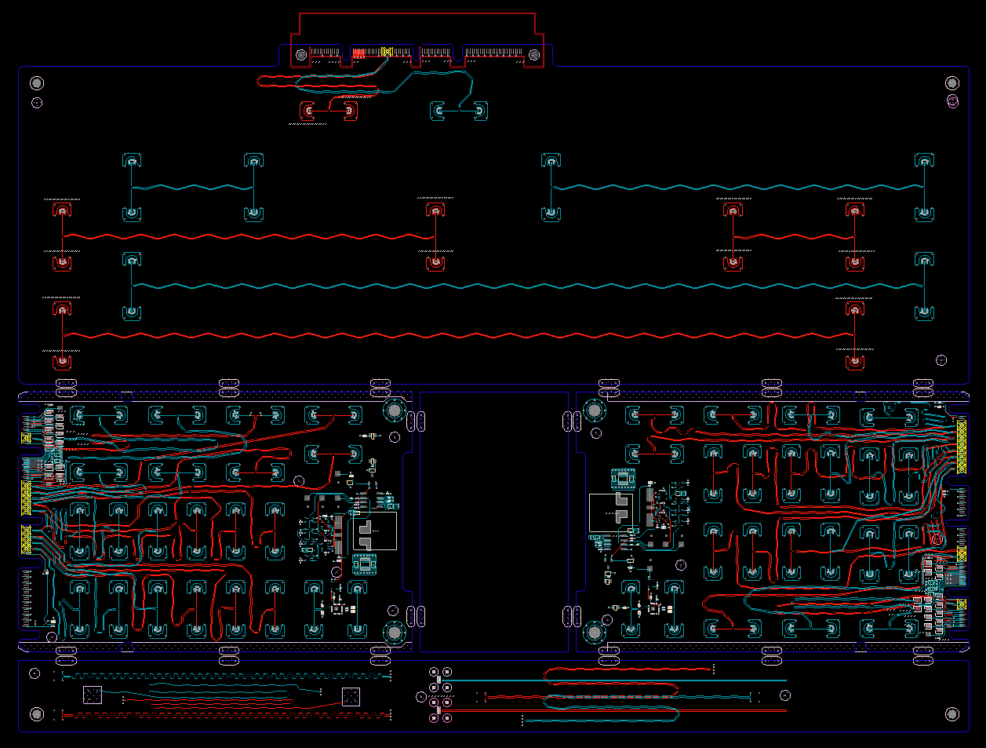
SI PCIe Gen5 test fixture update
Current CLB Gen5 status:
Schematic netlist done
ECAD cleanup
Thanks to the reviewers. Working through one last set of review actions
Gerber: 9 Dec 2021
CBB Gen 5 Status:
Updating to support SRIS
Estimated Review this month
Netlist block diagram
OCP3 SFF CLB Gen5 ECAD
Calibration
CLB board 1
CLB board 2
Impedance Coupon

Slide 5
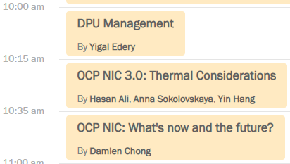
OCP Global Summit: Workshop presentations
Didn’t see offline recording available in Glo21 FNtech site yet

Slide 6
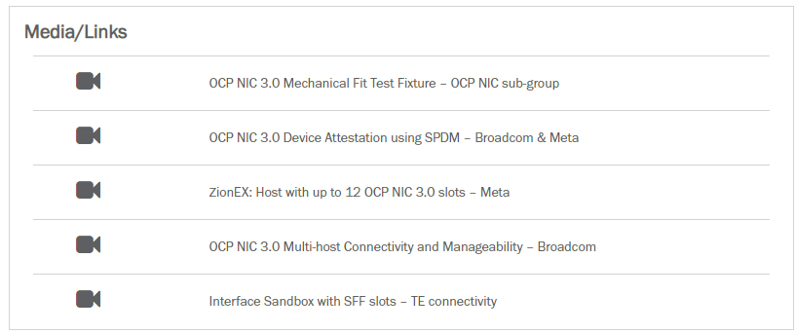
https://2021ocpglobal.fnvirtual.app/a/sponsor/91-server

Slide 7
OCP Global Summit: Lightning Talk
https://2021ocpglobal.fnvirtual.app/a/sponsor/91-server

Slide 8
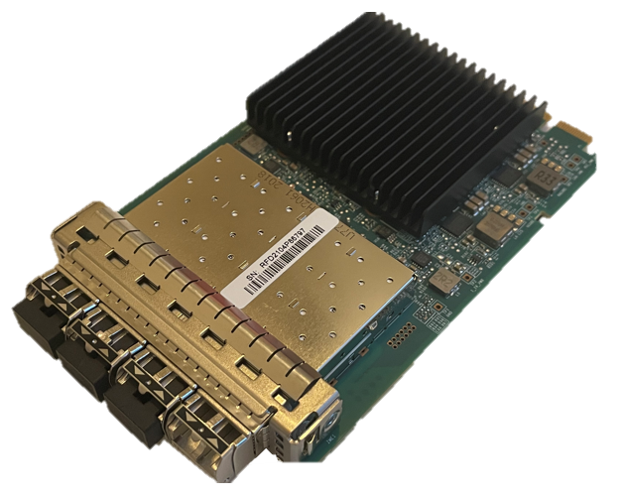
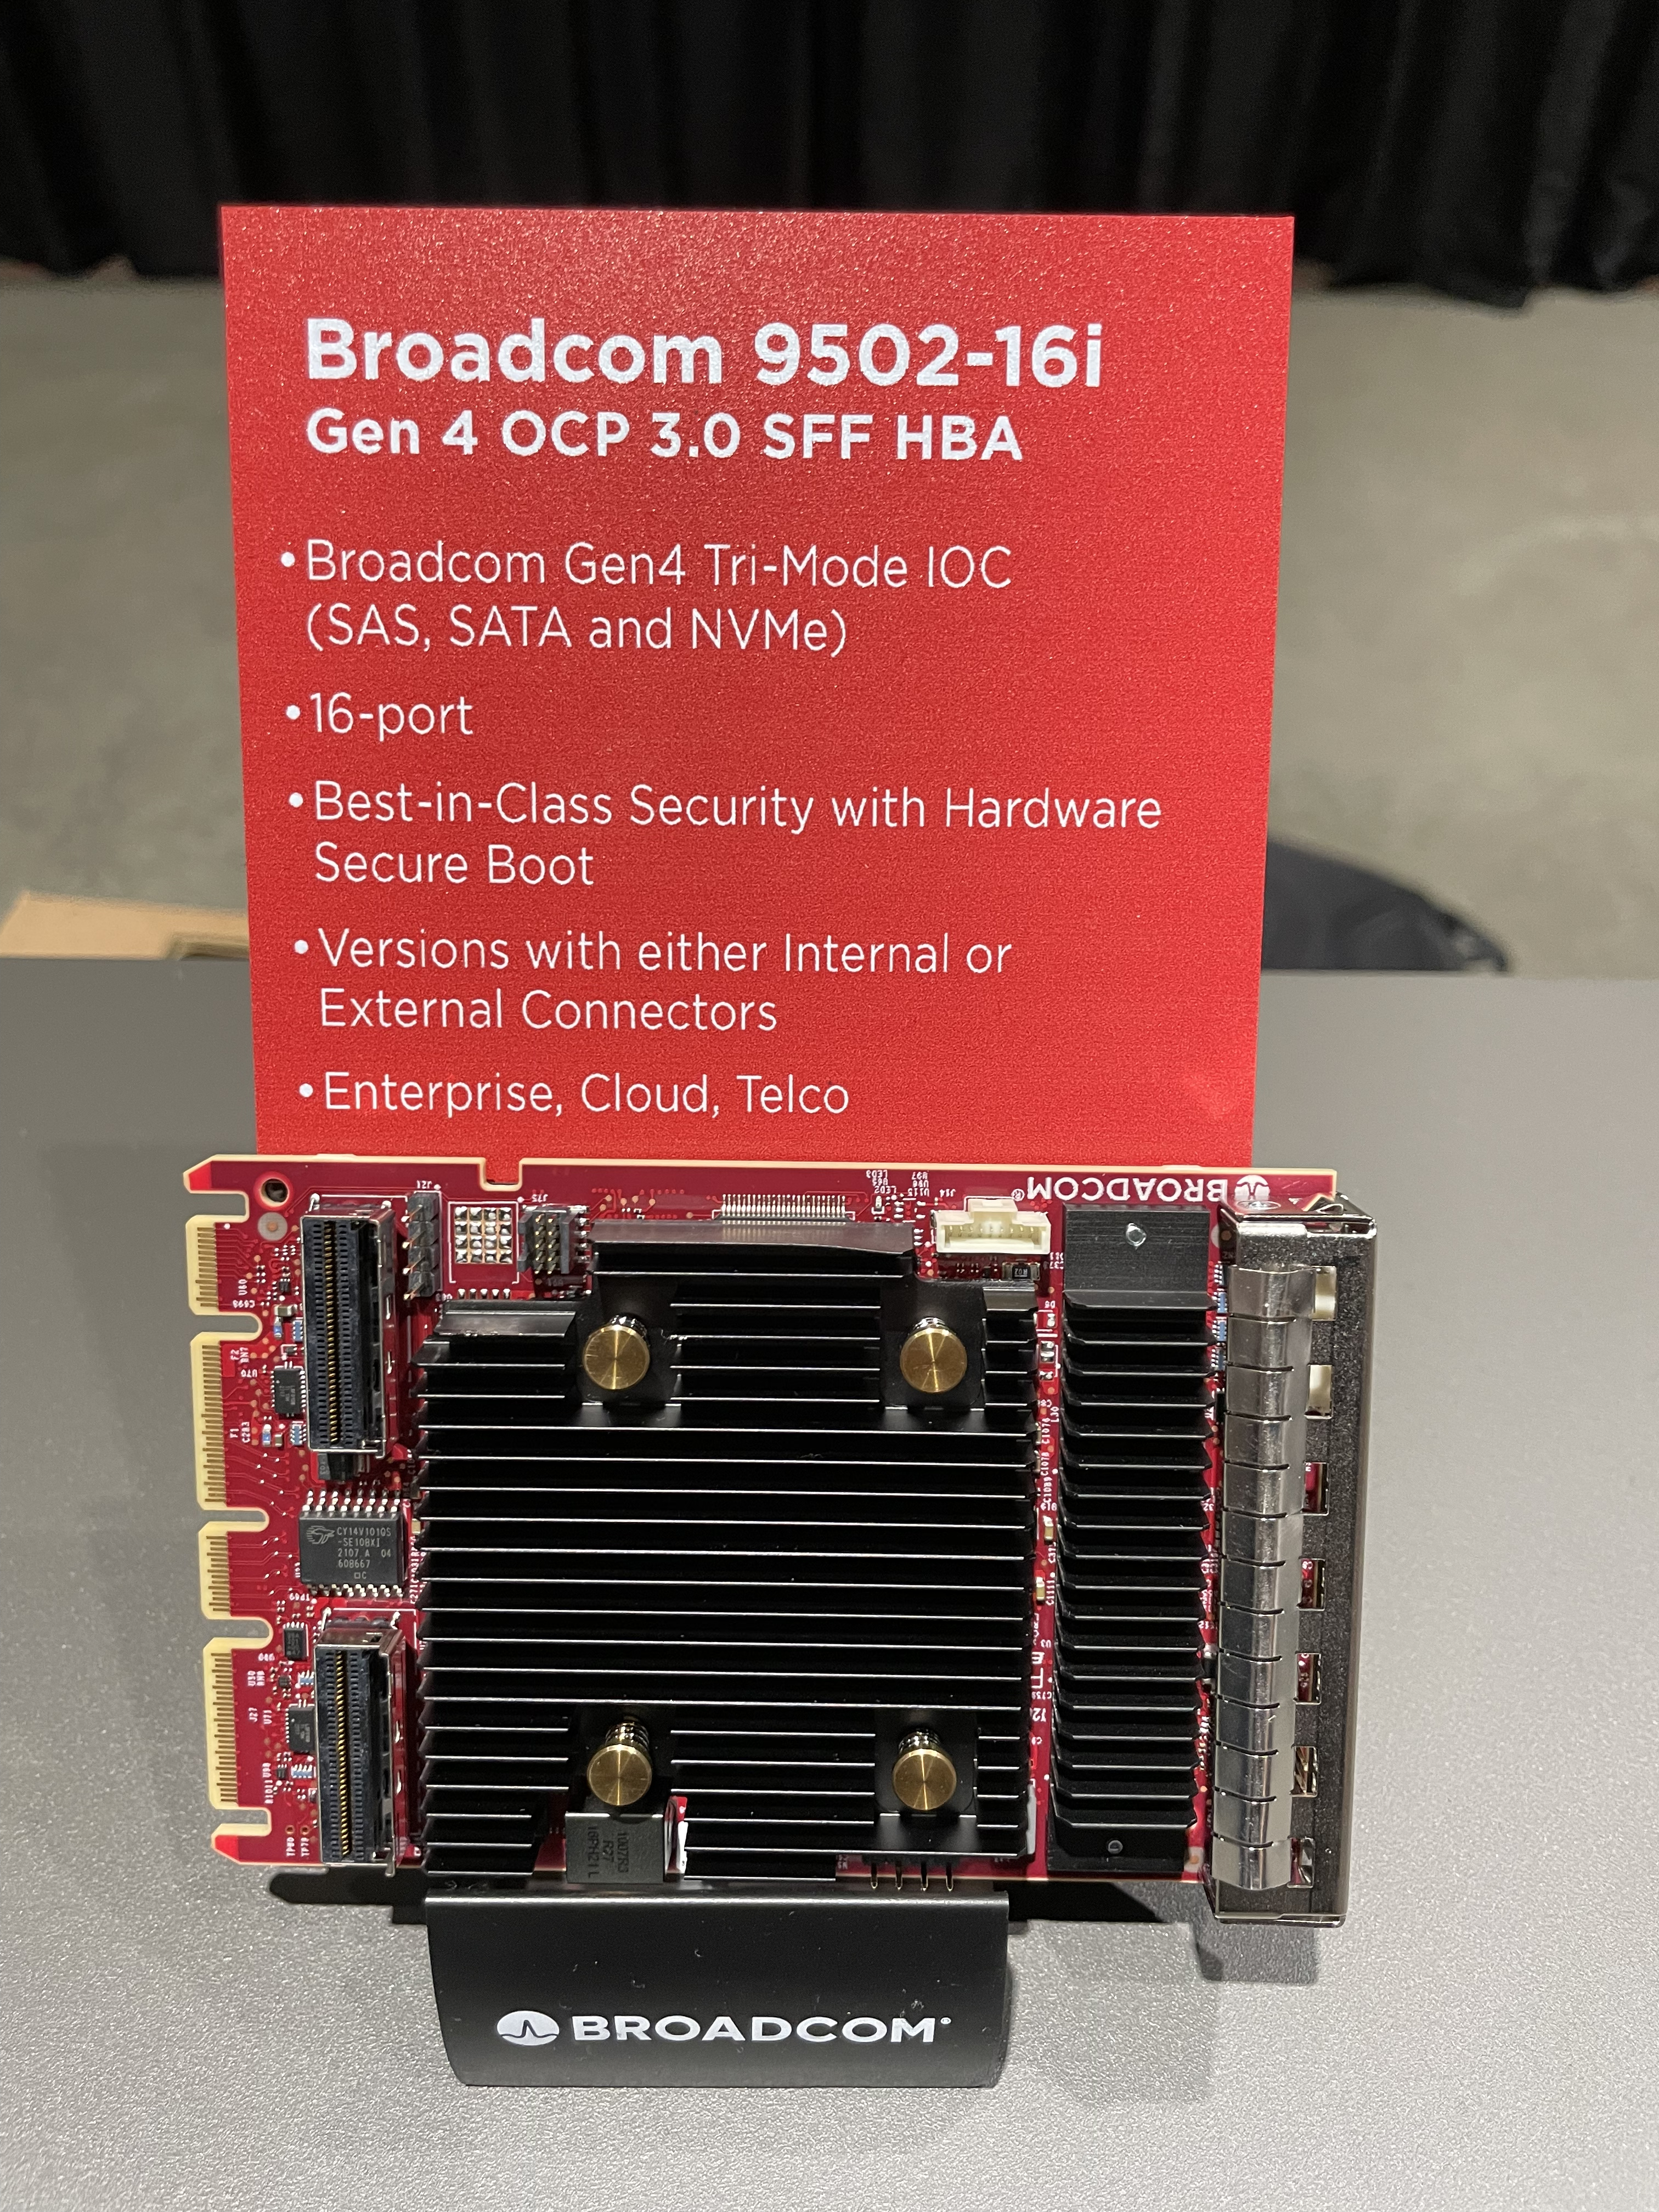
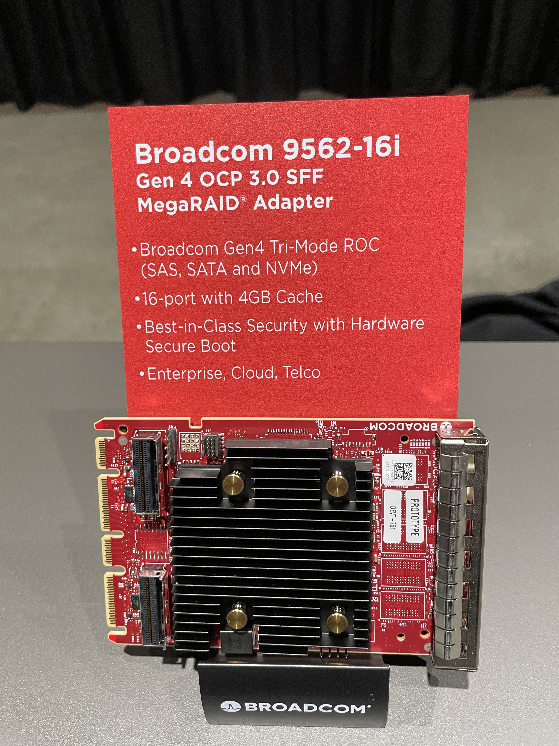
Non-NIC use-case highlights
Marvell Fiber-channel HBA

Slide 9
Thank You!
In-photo: Bapi, Sakthi, Vijay, David, Damien, Hemal, Rahul, Adrian, JP and Hsin-Yuan Off-photo: Todd, Roman, Ray, Chenxi, Tanuja, Natalie, Elad

Slide 10
Discussion bin list
Elegant cable-up solution
Zion uses 4C+ vertical connector to 4C+ saddle mount connector cable
1G NCSI/RGMII side-band support
PCIe Gen6 support
PCI-SIG spec at rev0.7

Slide 11
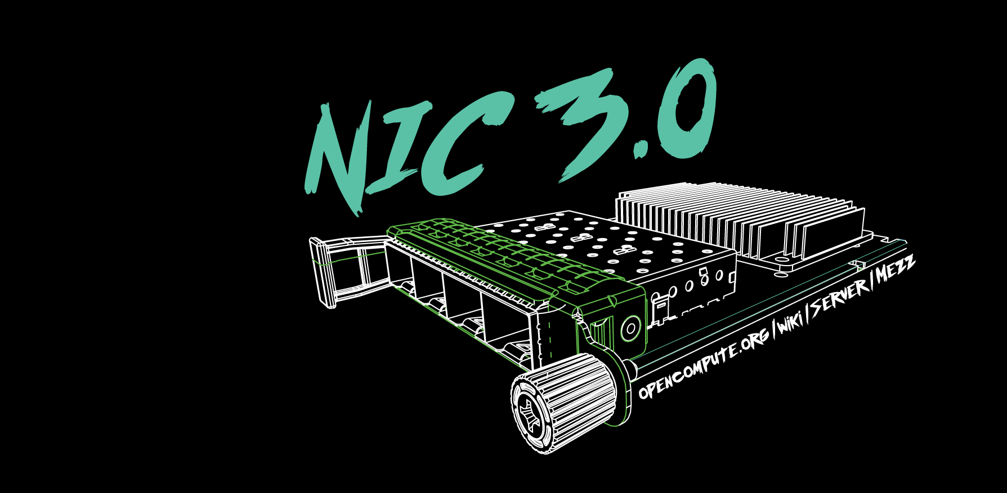

Slide 12
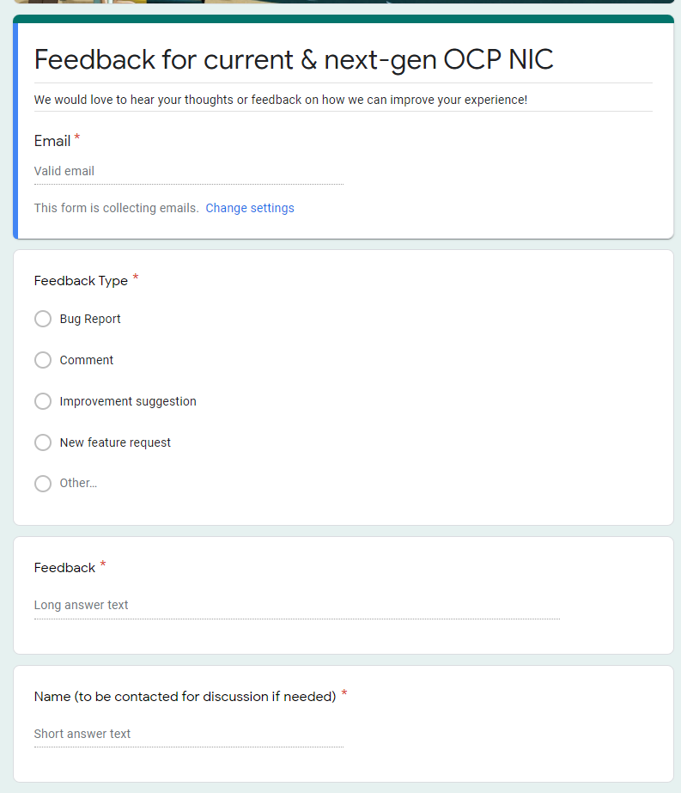
Gather feedback throughout the year
Provide your feedback at: https://tinyurl.com/feedback2ocpnic

Slide 13
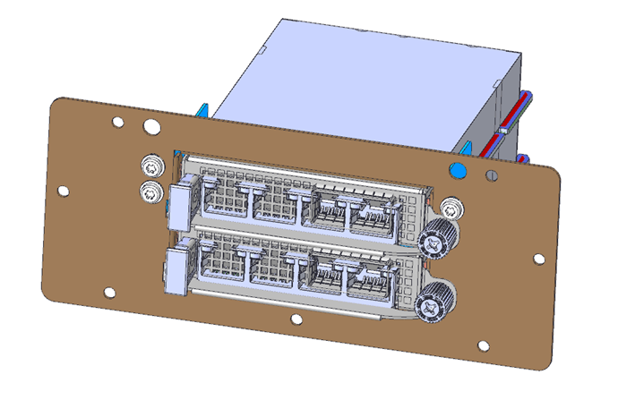
Thermal Test: TSFF TTF Status
Mechanical files received. Pending mechanical engineer peer review
Uses existing TTF with 3 different components to convert to TSFF.

Slide 14
NIC self-shutdown discussion
Get DMTF & HW management feedback
Discussion 1: NIC self shutdown as optional feature?
Discussion 2: NIC self shutdown as threshold?
Discussion 3: If NIC self shutdown implemented, it shall provide mechanism to enable/disable the feature?

Slide 15
NIC self-shutdown discussion
Discussion 1:
NIC self shutdown as optional feature
Keep as optional

Slide 16
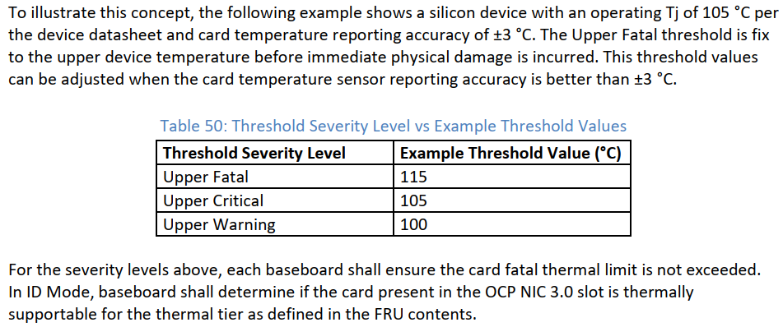
NIC self-shutdown discussion
Discussion 2:
NIC self shutdown as threshold
Change between to “at least”
Or remove this recommendation
Current recommendation

Slide 17
NIC self-shutdown discussion
Discussion 3:
If NIC self shutdown implemented, it shall provide mechanism to enable/disable the feature

